Slide 1


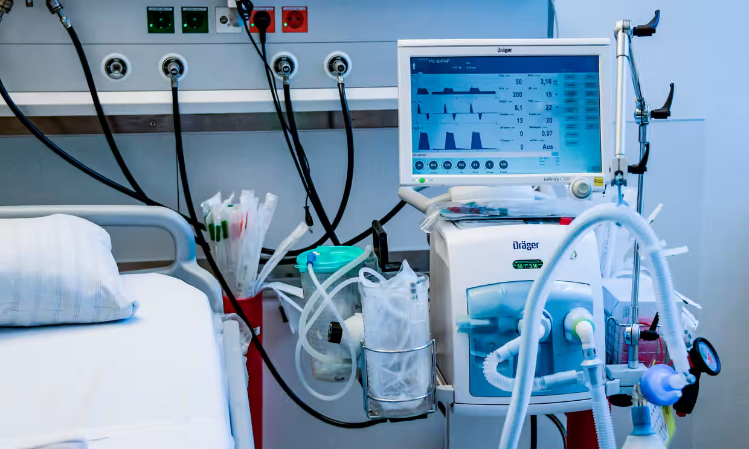
Hospital
Management System
Present By
Vinitkumar Dobariya
Jaykumar Sutariya
Instructor’s Name
Charles Yoo

Slide 2
Table Of Content
Introduction
Project Background
Technology Stack
Database Design
Entity-Relationship (ER) Diagram Explanation
Data Flow
User Interface Design
Future Enhancements
Conclusion
References

Slide 3

Introduction
Digitizes patient management end-to-end.
Utilizes Python and Django for efficiency and scalability.
Employs HTML, CSS and Java script for a user-friendly interface.
Aims to meet the dynamic needs of healthcare institutions

Slide 4
Project Background:
Centralizes patient records and schedules.
Provides administrative control over data.
Addresses issues like data fragmentation and manual errors.
Streamlines operations for error-resistant management.

Slide 5





Technology Stack
Python
Django
HTML
CSS

Slide 6
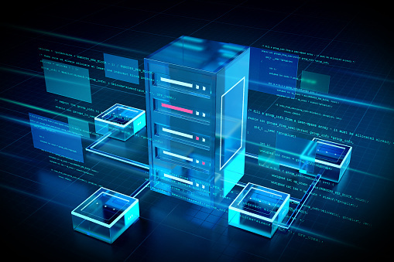
Database Design
Core Database Technology: Utilized SQLite, a lightweight, file-based database system known for its reliability, simplicity, and minimal configuration requirements.
Data Management: Designed for efficient data storage, retrieval, and manipulation, ensuring that all hospital data is organized and easily accessible.
Real-time Access: Provides real-time access to data, enabling immediate updates and retrieval which is crucial for time-sensitive hospital operations.
Scalability: The database architecture is scalable, capable of handling an increasing amount of data as the hospital grows.

Slide 7
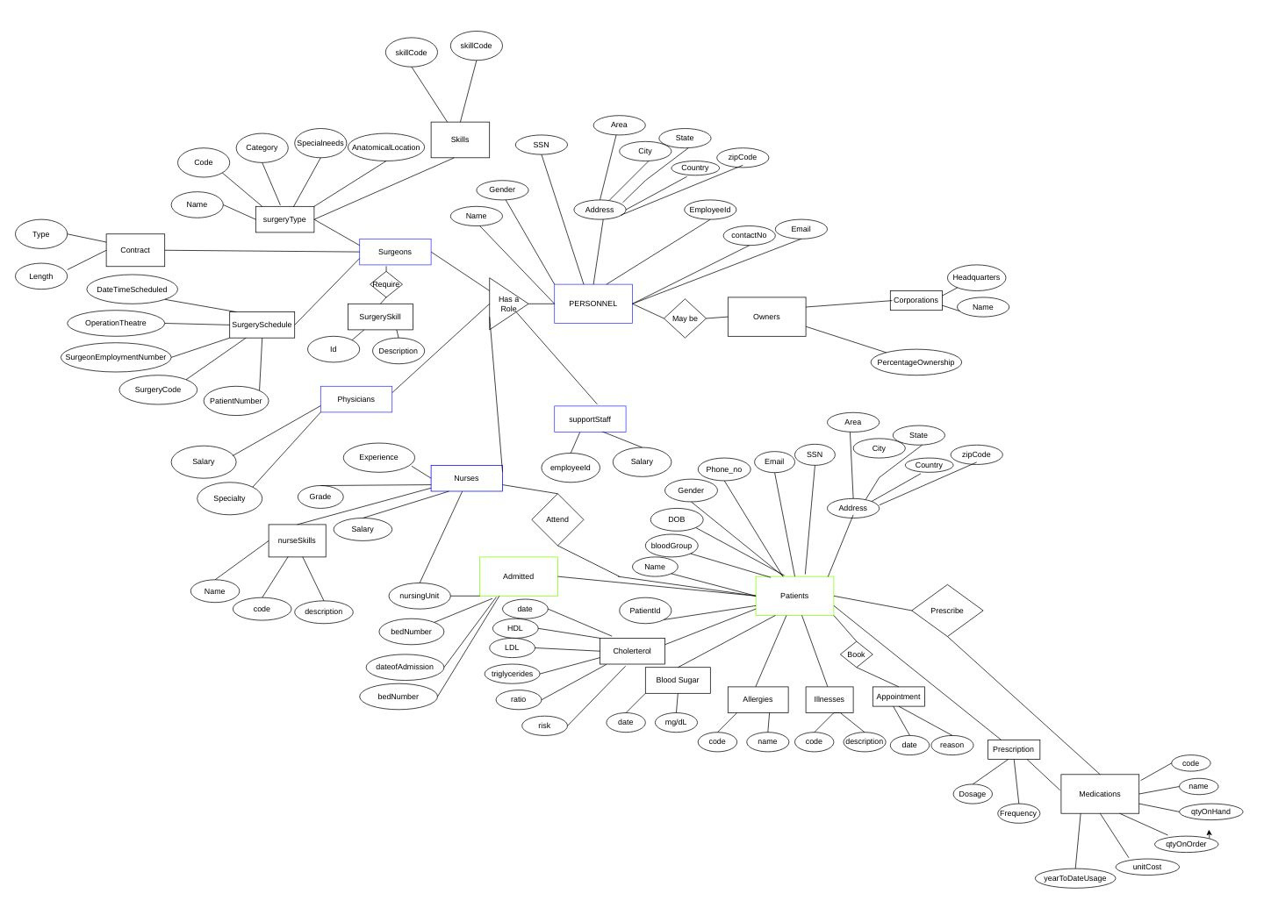
ER Diagram

Slide 8
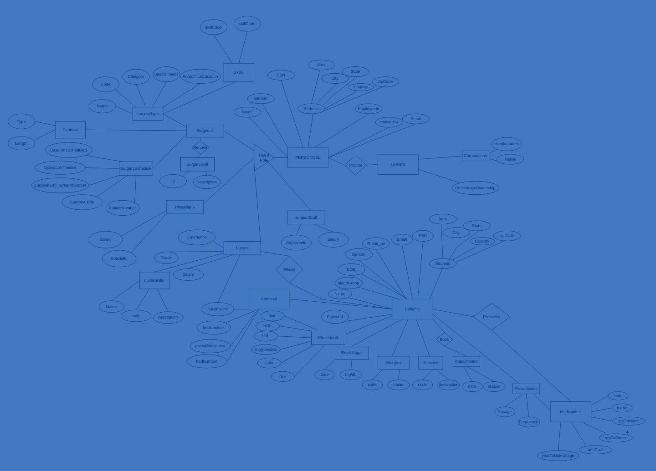
Entity-Relationship (ER) Diagram
Maps relationships between Patients, Doctors, Appointments, and Staff.
Highlights real-world hospital ecosystem interactions.
Patient-Doctor-Appointment links establish care schedules.
Ensures database logic, consistency, and integrity.

Slide 9


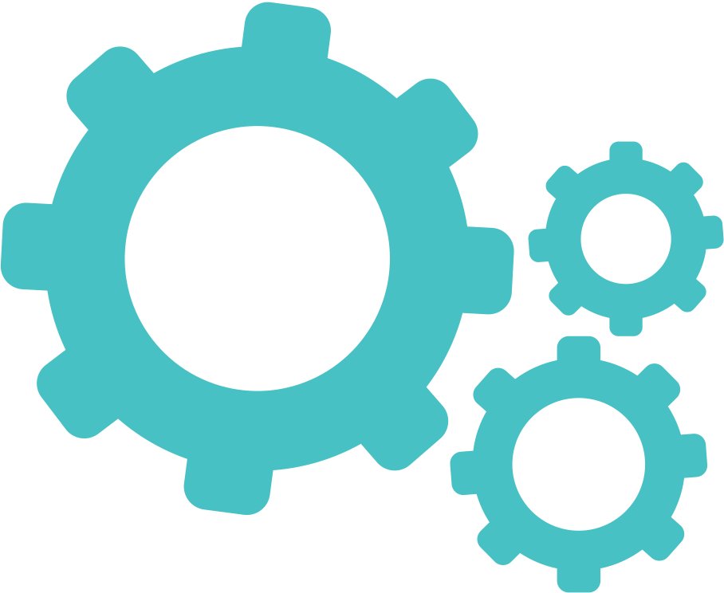
Database Features & Security
Robust Data Encryption
Regular Backups & Data Recovery
User Authentication and Authorization
System Interactivity:
Dynamic Search & Filter Options
Real-time Notifications & Alerts
Customizable Reporting Tools

Slide 10
Overview of Data Flow
Data enters the system via registration forms, appointment bookings, and administrative entries.
Automated processes funnel data to the correct databases—patients, staff, inventory.
Real-time data synchronization across departments ensures up-to-date information.

Slide 11
CRUD Operations in the System
Create: New records for patient admissions, staff hires, and inventory orders.
Read: Retrieval of patient histories, staff schedules, and current stock levels.
Update: Modifications to records such as patient treatments, staff roles, and inventory status.
Delete: Removal of outdated or incorrect information, with secure protocols to prevent data loss.

Slide 12

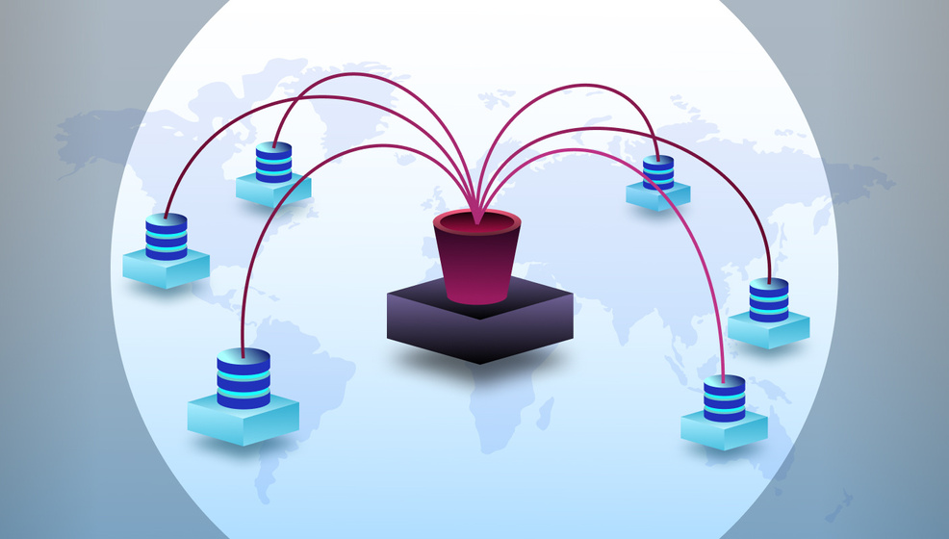
Data Flow in Action
Registration process triggers a new patient record, which is then available for appointments.
Doctors' updates to patient records are immediately reflected in the patient's history.
Inventory management system automatically updates as medications and supplies are used.
Secure data deletion processes ensure compliance with privacy regulations and data protection laws.

Slide 13
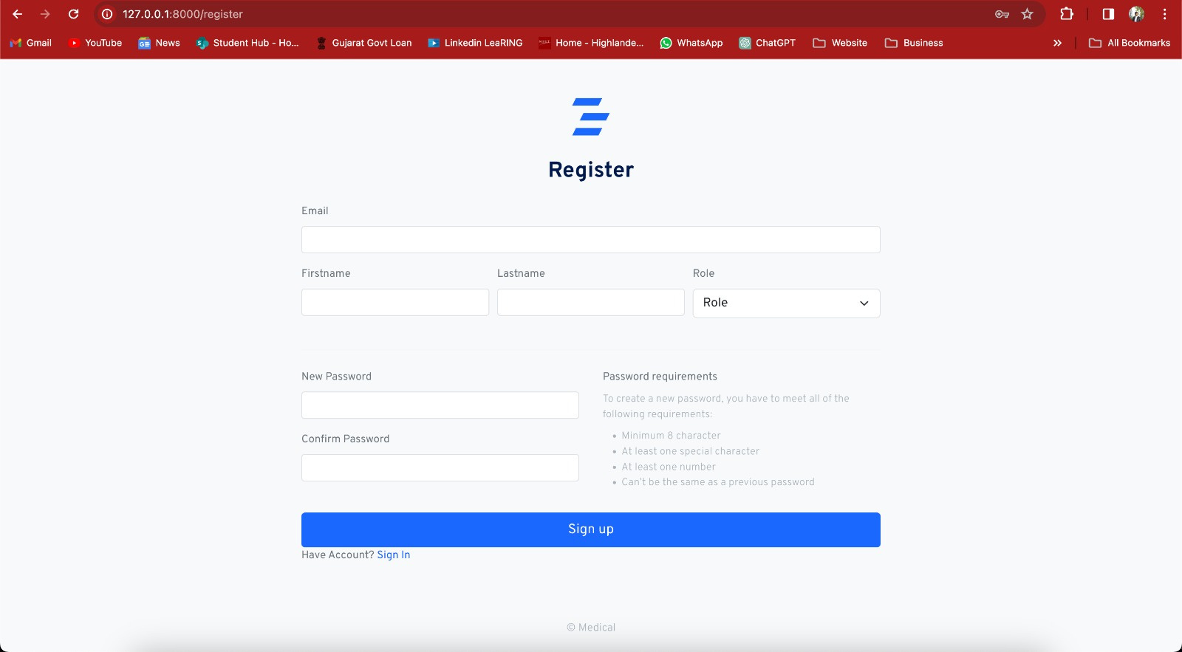
User Interface Design

Slide 14
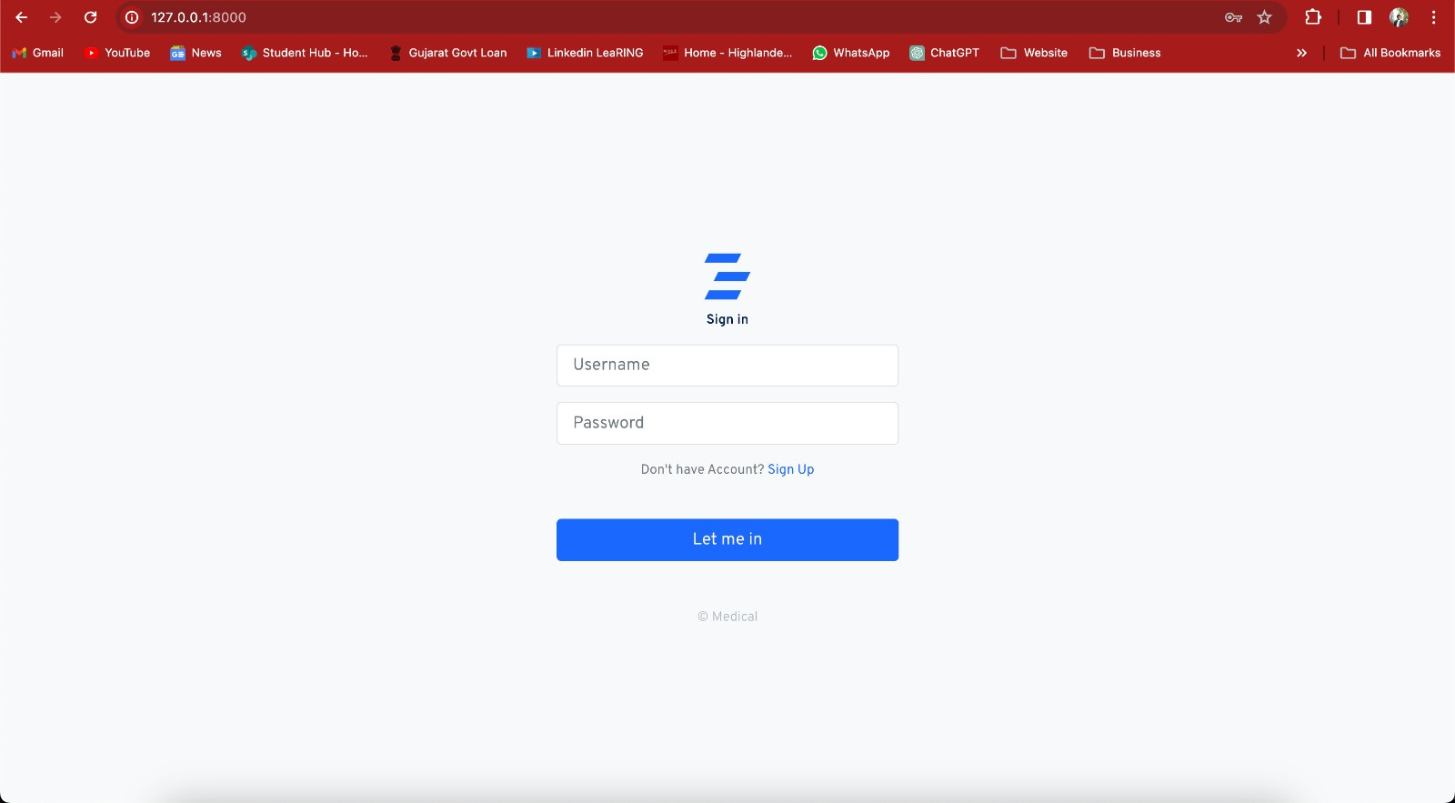
User Interface Design

Slide 15
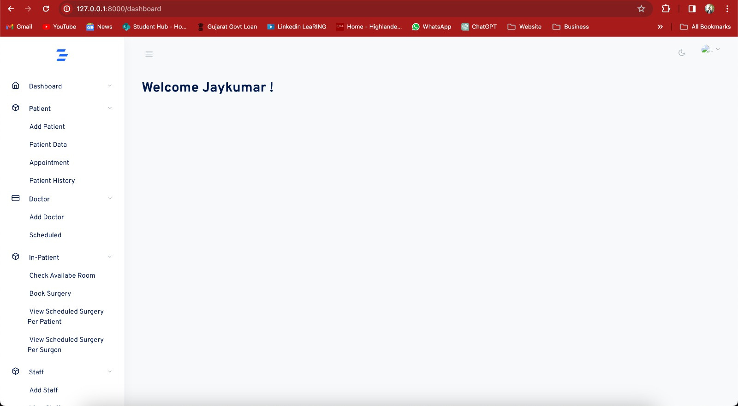
User Interface Design

Slide 16
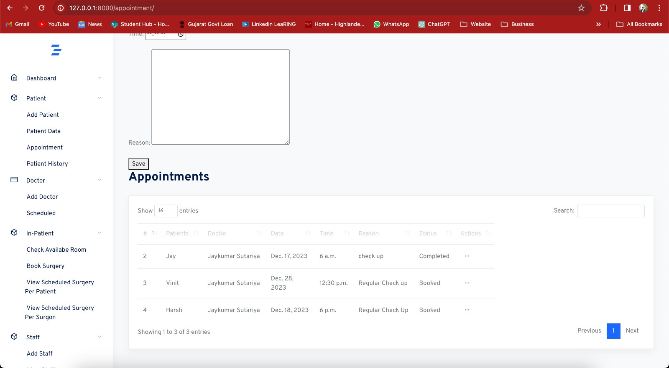
User Interface Design

Slide 17
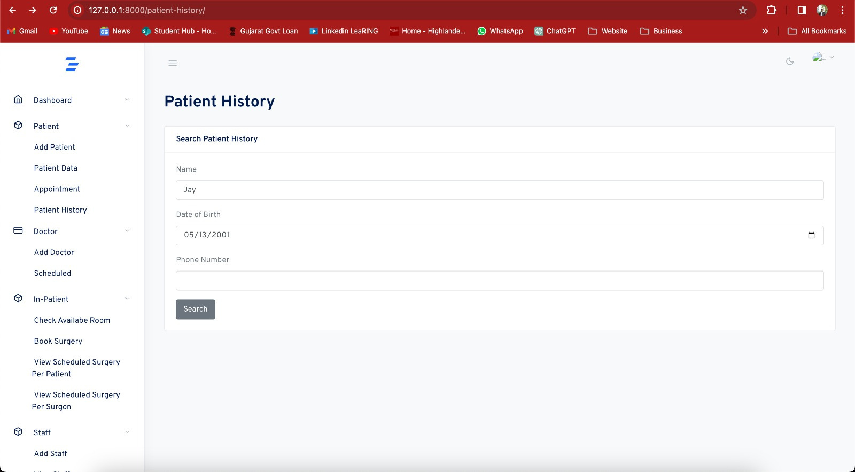
User Interface Design

Slide 18
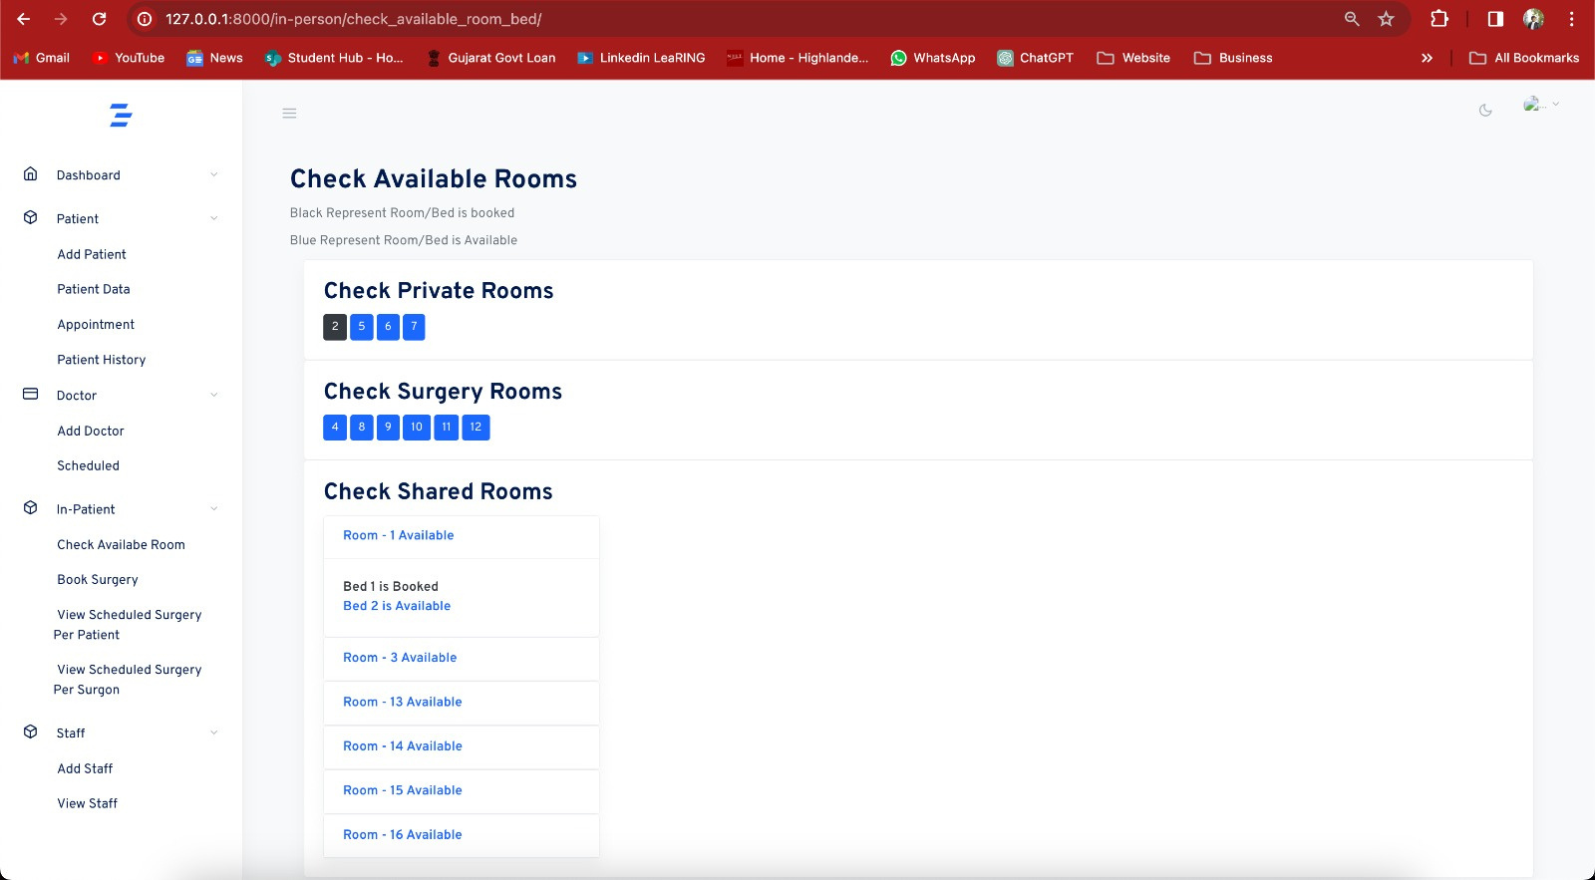
User Interface Design

Slide 19
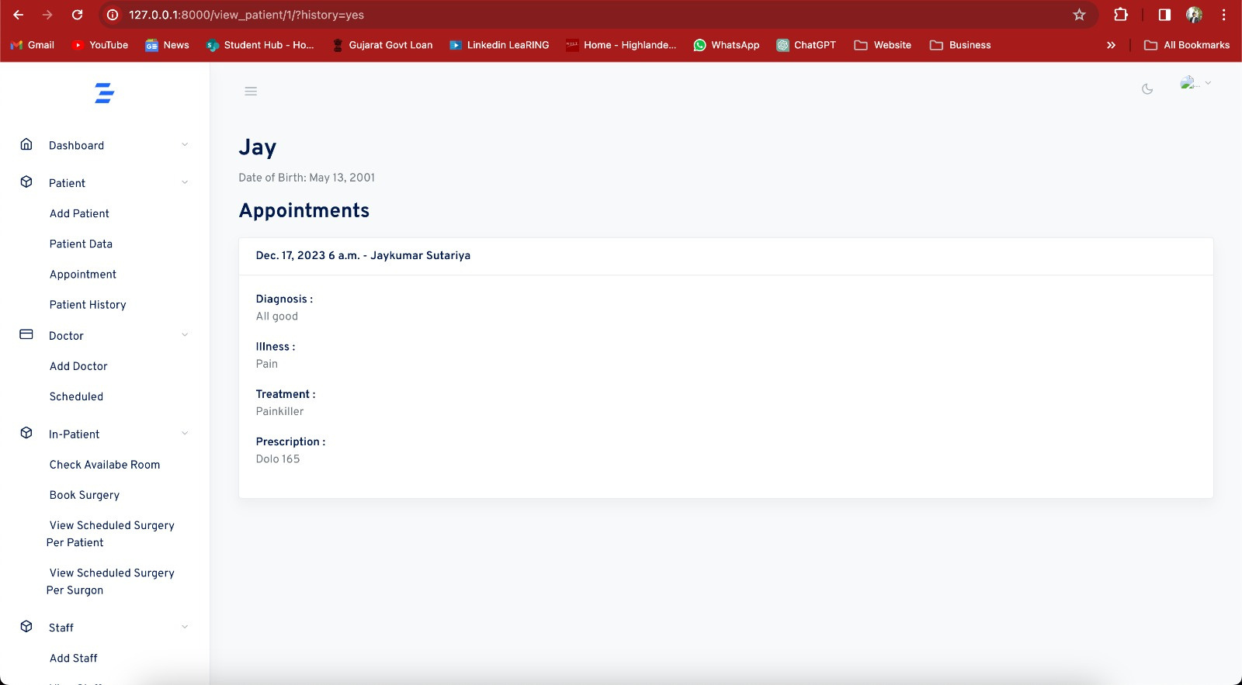
User Interface Design

Slide 20
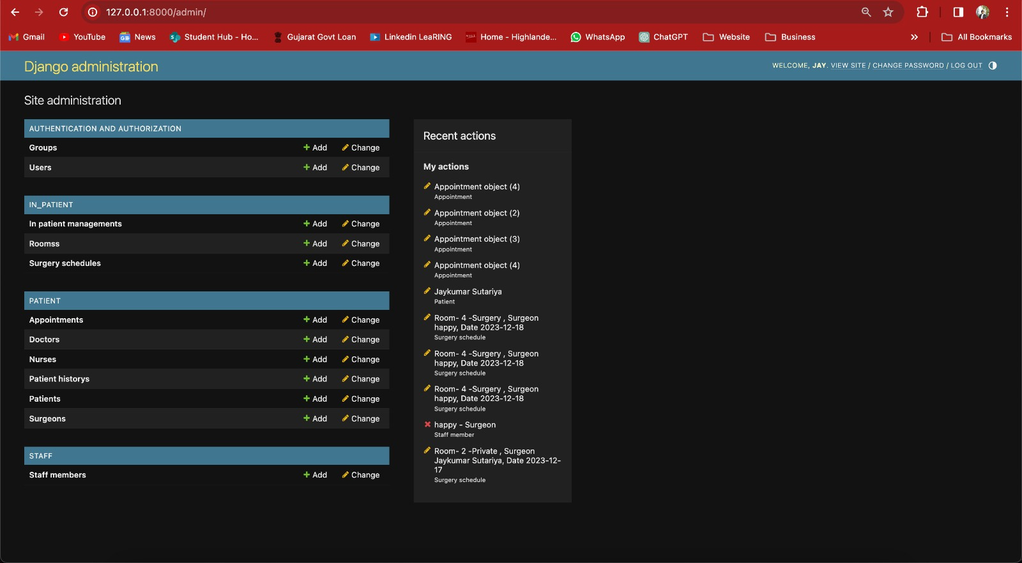
User Interface Design

Slide 21
Future Enhancements
Telemedicine Integration: Expand services to include remote diagnosis and consultations.
Machine Learning: Implement predictive analytics for patient care and hospital logistics.
Patient Portal Expansion: Provide patients with more access to their medical records and health management tools.
Interoperability: Improve system compatibility with external healthcare databases and services.
Mobile Application: Develop a dedicated app for on-the-go access for patients and staff.

Slide 22
Challenges Faced
Data Security: Implementing stringent security measures to protect sensitive patient data.
User Interface Compatibility: Ensuring the system is user-friendly across various devices.
Interdepartmental Data Flow: Achieving seamless data sharing among different hospital departments.
Regulatory Compliance: Aligning system operations with healthcare regulations.

Slide 23
Conclusion
Project Impact: Successfully digitized hospital management, improving efficiency and patient care.
Technological Integration: Showcased the effective use of Python, Django, HTML, and CSS in healthcare.
Learning Experience: Gained valuable insights into the complexities of database systems in medical environments.
Looking Ahead: Confident in the system’s foundation and potential for future advancements.

Slide 24

References
https://docs.djangoproject.com/en/5.0/
https://www.w3schools.com/
https://www.webmd.com/cold-and-flu/what-are-epidemics-pandemics-outbreaks

Slide 25
Thank You :)

